Slide 1
Computer Networks
CS 430

Slide 2
Transport Layer

Slide 3
Objectives
Transport-layer services
Multiplexing and demultiplexing
Connectionless transport: UDP
Principles of reliable data transfer
Connection-oriented transport: TCP
segment structure
reliable data transfer
flow control
connection management
Principles of congestion control
TCP congestion control

Slide 4
Transport Services
Logical communication between applications
End system protocol
TCP vs UDP
Application layer
Messages
Transport layer
TCP segments
UDP datagrams
Network layer
Packets
Link-local
Frames

Slide 5
Transport vs. Network Layer
Transport layer
Network layer
Protocol(s)
TCP, UDP
Communication between
Processes
Identifier used
Port
Reliability
Possible
Protocol(s)
IP, IPv6
Communication between
Hosts
Identifier used
IP address
Reliability
None

Slide 6
Transport Layer Protocols
TCP
Congestion control
Flow control
Connection setup
UDP
Best-effort delivery
Unavailable services
Delay guarantee
Bandwidth guarantee

Slide 7

Multiplexing/demultiplexing
multiplexing at sender:
handle data from multiple
sockets, add transport header (later used for demultiplexing)
demultiplexing at receiver:
use header info to deliver
received segments to correct
socket
application
application
P1
P2
application
socket
P3
transport
P4
process
transport
network
transport
network
link
network
link
physical
link
physical
physical

Slide 8
How Demultiplexing Works
Host receives IP packet
each packet has source IP address, destination IP address
each packet carries one transport-layer segment
each segment has source, destination port number
Host uses IP addresses & port numbers to direct segment to appropriate socket
32 bits
source port #
dest port #
other header fields
application
data
(payload)
TCP/UDP segment format

Slide 9
Connectionless Demux: Example
DatagramSocket mySocket2 = new DatagramSocket
(9157);
DatagramSocket mySocket1 = new DatagramSocket (5775);
application
application
P1
application
P3
P4
transport
transport
network
transport
network
link
network
link
physical
link
physical
physical
source port: 6428
dest port: 9157
source port: ?
dest port: ?
source port: 9157
dest port: 6428
source port: ?
dest port: ?

Slide 10
Connection-oriented demux
TCP socket identified by 4-tuple
source IP address
source port number
dest IP address
dest port number
demux: receiver uses all four values to direct segment to appropriate socket
server host may support many simultaneous TCP sockets:
each socket identified by its own 4-tuple
web servers have different sockets for each connecting client
non-persistent HTTP will have different socket for each request

Slide 11
Connection-oriented Demux: Example
threaded server
application
application
P4
P5
P6
application
P1
P2
P3
transport
transport
network
transport
network
link
network
link
physical
link
physical
server: IP address B
physical
host: IP address A
source IP,port: B,80
dest IP,port: A,9157
host: IP address C
source IP,port: C,5775
dest IP,port: B,80
source IP,port: A,9157
dest IP, port: B,80
source IP,port: C,9157
dest IP,port: B,80
three segments, all destined to IP address: B,
dest port: 80 are demultiplexed to different sockets

Slide 12
User Datagram Protocol

Slide 13
User Datagram Protocol
RFC 768
Best effort service, UDP segments may be
lost
delivered out-of-order to app
Connectionless
no handshaking between UDP sender, receiver
each UDP segment handled independently of others
UDP use
streaming multimedia apps (loss tolerant, rate sensitive)
DNS, DHCP, NTP, SNMP etc.
Reliable transfer over UDP
Add reliability at application layer
Application-specific error recovery!

Slide 14
UDP: segment header
32 bits
Why UDP?
No connection establishment (which can add delay)
Simple: no connection state at sender, receiver
Small header size
No congestion control: UDP can blast away as fast as desired
MGEN
source port #
dest port #
length
checksum
application
data
(payload)
UDP segment format

Slide 15
UDP Checksum
Sender
Receiver
Treat segment contents, including header fields, as sequence of 16-bit integers
Checksum: addition (one’s complement sum) of segment contents
Sender puts checksum value into UDP checksum field
Compute checksum of received segment
Check if computed checksum equals checksum field value:
NO - error detected
YES - no error detected. But maybe errors nonetheless?

Slide 16
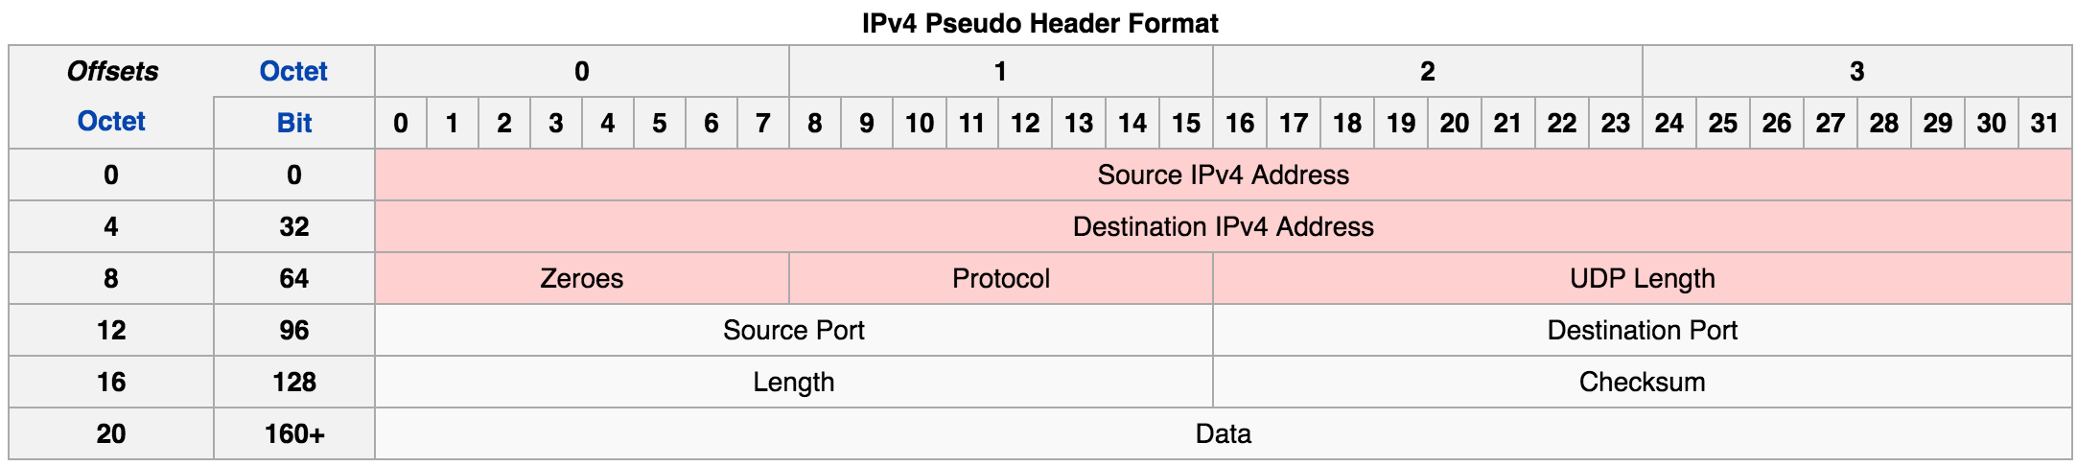
IP Pseudo Header

Slide 17
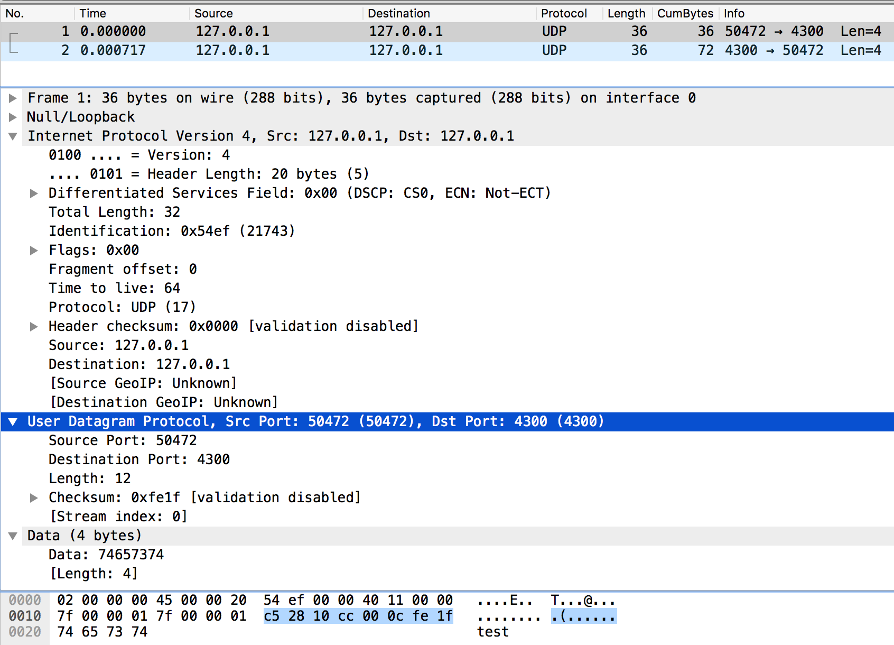
UDP Checksum

Slide 18
UDP Checksum
 | 0 | 1 | 2 | 3 | 4 | 5 | 6 | 7 | 8 | 9 | 10 | 11 | 12 | 13 | 14 | 15
Src IP (1) | 0 | 1 | 1 | 1 | 1 | 1 | 1 | 1 | 0 | 0 | 0 | 0 | 0 | 0 | 0 | 0
Src IP (2) | 0 | 0 | 0 | 0 | 0 | 0 | 0 | 0 | 0 | 0 | 0 | 0 | 0 | 0 | 0 | 1
SUM
Dst IP (1) | 0 | 1 | 1 | 1 | 1 | 1 | 1 | 1 | 0 | 0 | 0 | 0 | 0 | 0 | 0 | 0
SUM
Dst IP (2) | 0 | 0 | 0 | 0 | 0 | 0 | 0 | 0 | 0 | 0 | 0 | 0 | 0 | 0 | 0 | 1
SUM
Zero+Proto | 0 | 0 | 0 | 0 | 0 | 0 | 0 | 0 | 0 | 0 | 0 | 1 | 0 | 0 | 0 | 1
SUM
UDP Length | 0 | 0 | 0 | 0 | 0 | 0 | 0 | 0 | 0 | 0 | 0 | 0 | 1 | 1 | 0 | 0
SUM
Src Port | 1 | 1 | 0 | 0 | 0 | 1 | 0 | 1 | 0 | 0 | 1 | 0 | 1 | 0 | 0 | 0
SUM
Dst Port | 0 | 0 | 0 | 1 | 0 | 0 | 0 | 0 | 1 | 1 | 0 | 0 | 1 | 1 | 0 | 0
SUM
Length | 0 | 0 | 0 | 0 | 0 | 0 | 0 | 0 | 0 | 0 | 0 | 0 | 1 | 1 | 0 | 0
SUM
Chk Sum | 0 | 0 | 0 | 0 | 0 | 0 | 0 | 0 | 0 | 0 | 0 | 0 | 0 | 0 | 0 | 0
SUM
DATA (1) | 0 | 1 | 1 | 1 | 0 | 1 | 0 | 0 | 0 | 1 | 1 | 0 | 0 | 1 | 0 | 1
SUM
DATA (2) | 0 | 1 | 1 | 1 | 0 | 0 | 1 | 1 | 0 | 1 | 1 | 1 | 0 | 1 | 0 | 0
SUM
1s COMP

Slide 19
Summary
Transport-layer services
Multiplexing and demultiplexing
Connectionless transport: UDP

Slide 20
Thank You!

